Slide 1
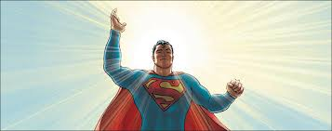
All-Star Superman

Slide 2
Agenda:
Superman Paradigms
Superman’s Characterization
Renaissance and Enlightenment Figure
Narrative Form
Use of Myth
Various Episodes

Slide 3
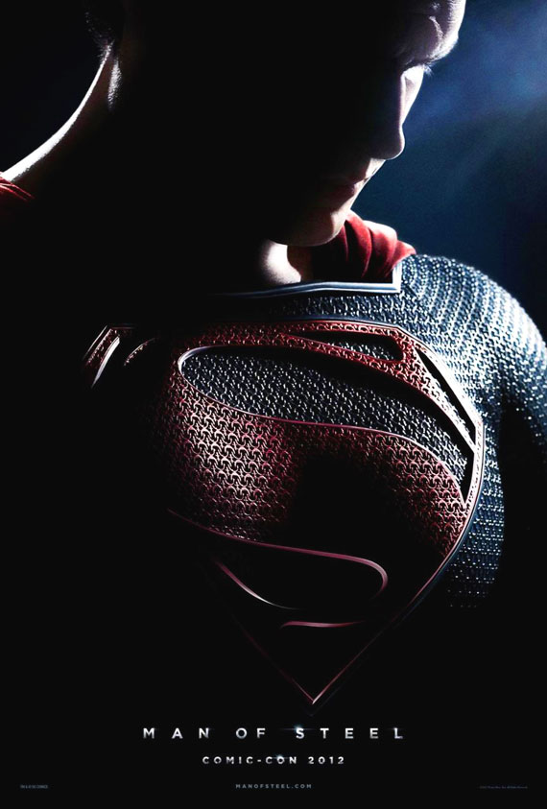
Superman

Slide 4
The Birth of Superman
Kill Bill: http://www.youtube.com/watch?v=I_cEoK1mXms
Superman is the ideal, the fantasy that spawned the comic book industry
His origins are Cleveland, Ohio. IN 1934 two high-school students Jerry Siegel and Joe Schuster created the character
Lower-middle-class, second generation Jewish immigrants, both believed in the American dream
They were “shy,” “unpopular,” “unsuccessful with girls”
Fantasies of power and success

Slide 5
Golden Age of Comic Books: Superman’s Arrival
The people who ran the newspaper syndicates did not find Superman appealing at first
Their proposed comic strip was rejected numerous times
Joe Shuster once tore up his Superman artwork
In the mean time, they were doing freelance work for DC comics but held back Superman –they wanted to launch him as a newspaper comic strip
In June 1938, Superman was the lead feature in the first issue of a new DC comic book title called Action Comics
13 page comic book story
Superman was sold to DC Comics for $130
Now he is one of the most recognized figures in the world

Slide 6
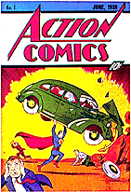
June 1939, Action Comics

Slide 7
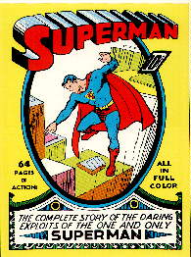
1939: DC launches Superman
The first comic book title devoted to a single character
Evolution of logo: http://dialbforblog.com/archives/374/
Up until this point, all comic books had a variety of characters and stories in them.

Slide 8
Birth of Batman
Around the same time, Detective Comics #27 hit the stands in In May, 1939.
It featured the first appearance of Batman (Bob Cane, illustrator).
While Superman was morally pure and clean, where as Batman was dark, grim, and rough
During a time when superhero comics were not so popular, Batman survived by focusing on his detective abilities, carried the appeal of mystery stories than a superhero book.
Batman not a traditional superhero with superpowers
His popularity was attributed to his intellect, costume, and gadgets that made him like a superhero.

Slide 9
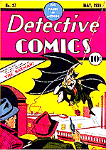
May 1939, Detective Comics #27

Slide 10
The American Superhero: “Truth, Justice, and the American Way”
Mainstream superheroes have had a history of functioning as symbols of ideal American value systems
Superman was a variation of the classic American hero archetype: The Western frontier hero
He resolves conflicts between the wilderness and civilization while embodying the best virtues of both environments: in Superman’s case, this would be the virtues of the planets Krypton and Earth
The Western frontier hero tames the savage American frontier

Slide 11
The Common Man
After this, the depression-era (1929-39) saw a rise of the common man as the American hero: the idea that virtue resided within the everyday American man
Clark Kent spoke to this belief and Superman became the defender of the oppressed.
But the common man was not enough
Only the strength and might of Superman could prevail over systems of justice
He solved world problems, not just American ones
Most of the earlier books: morality tales, cautionary tales

Slide 12
Themes of Superman Stories
1. Social reform
2. Social justice
3. Redemptive violence & messianic deliverance
4. Fate and individual responsibility
5. Subordination of women and minority cultures
6. The limits & celebration of science & technology
7. Utopia & dystopia
8. The immigrant experience
9. Duality of Birth and Rebirth: Christian story

Slide 13
Superman Paradigms
1 Individual triumph: Enlightenment figure
Individual-centered held in contrast with the ideology of the collective good
Superman is superior in intelligence, will power, strength, and ingenuity
He has boundless power. American fantasy-wish fulfillment
2. Heroism marked by sexual renunciation (earlier comics)
Superman is a single saviour
Superman is emotionally unavailable
Committed to higher purposes—sexually and emotionally removed

Slide 14
Superman Paradigms cont’d..
3. Democratic Equality:
democratic model that paradoxically based on impotent judicial / legal institutions; instead relying on a extralegal superhero
Ordinary power of the citizen is too weak
Total power of the superhero is non-threatening (kind, compassionate, non-violent)
This gave birth to the emergence of lawless vigilantism—vigilantes became law enforcers

Slide 15
Superhero Paradigms cont’d…
4. Redemption
Redemption is displaced on the superhero rather than the god (redeeming the individual)
Superman provides a secular fulfillment of religious promises and expectations
He is the secular supersaviour / saint
what problems, if any, do you see with this “myth of redemption”?

Slide 16
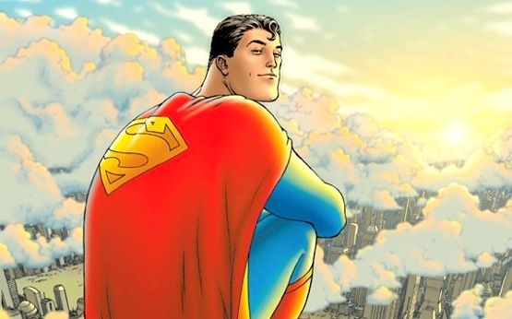
All-Star Superman
12 issue comic book
(episodes)
Written by Grant Morrison
Drawn by Frank Quitely
Digitally inked by Jamie Grant
Apart of a larger “All-Star” series by DC comics, launched in 2005
Ran until 2008

Slide 17
Approach: Morrison’s “Mythical Method”
“Shamanic vision” of Superman
Show the “light” in humanity
Aim to “restore Superman to his pre-eminent place”
Reboot (not redo) him with a fresh approach
Update with timeless issues; honor his legacy/dynasty; pay tribute to Golden Age and Silver Age Superman
Re-establishes and renews Superman mythos

Slide 18
The Mythos of Superman
1. Christian Myth
2. Greek Myth
3. Myth of the Solar God (self-sacrificing)
All three treat the core issue:
the problem of death

Slide 19
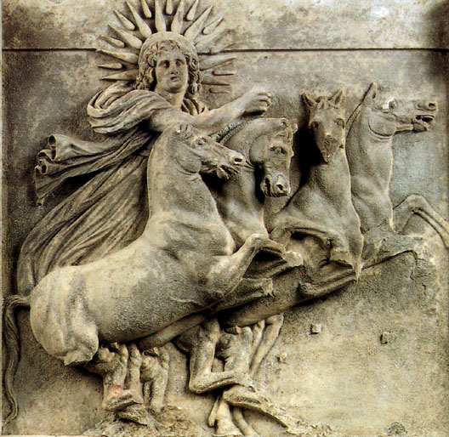
Myth of the dying Solar God
Self-sacrifice
For good and well-bing of others
Conflict itself is not resolved by one side defeating the other
Conflict itself is transcended (Greene 136)
Life does not conquer death
Synthesis

Slide 20
Superman’s battle
Conflict with the meaning of death
Is it just absence?
It is redemptive?
Is it nothingness?
Jung: conflict brings about “individuation”

Slide 21
The Duality of Superman
Clark Kent Regular guy Mild mannered Meek & modest Raised with midwest values, agrarian society Has parents, an origin story Has a sense of belonging to a community; to place and time | Superman Wants to connect with the common man Herculean strength: Man of Steel Honourable Lost origins, dead parents (loss of the father is foreground Exiled, dislocated

Slide 22
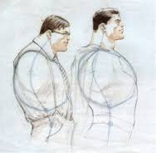
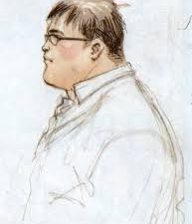
Secret Identity

Slide 23
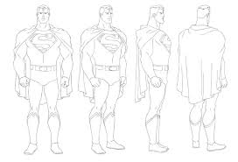
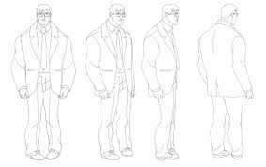
Superman / Clark Kent

Slide 24
Superman’s Characterization: All-Star Superman
Superman as the sun-god-but still relatable
“Superman as dreamself of everyman” –Morrison
“That “S” is the radiant emblem of divinity we reveal when we rip off our stuffy shirts, our social masks, our neuroses, our constructed selves, and become who we truly are.”-Morrison
While he is portrayed as god-like, his humanity is emphasized
Unlike Batman, tragedy is not his story
Embodies humility, strength to overcome adversity; love; benevolence; altruism; selflessness
He embodies values of wisdom, temperance, fortitude and justice
He works through emotional conflict

Slide 25
Superman as Redeemer
Christ-like overlaps
Not passive; he is a fighter
Secular saint / messiah
“pagan sci-fi”
Very clear moral code

Slide 26
Renaissance values:
Age of Discovery & Scientific Method
known for 3 most significant discoveries: characterizes it as period of progress and reason
1. Copernicus (1473-1543)-idea of the heliocentric universe (sun) vs geocentric universe (earth)
2. Galileo (1564-1642)
Confirmed Copernicus
Through the invention of the telescope (1609)
Theory of Gravity
3. The microscope (17th century)-Anton van Leewenhoek

Slide 27
Enlightenment Values
Known as “Age of reason”
Superman is the embodiment of the enlightenment individual
Emphasis on the new individual and reason as a measure of the individual and humanity
“I think therefore I am”-Descartes
Empirical thought-goals of rationality—scientific reason can solve all problems

Slide 28
Narrative Form
Follows linear storyline; progression
Blend of fantasy and reality
Stylistically structured so that past and future merge with present
12 issues stand for 12 months Superman has to live—each episode is a countdown to the end
12 issues-for 12 great tasks (suggesting his super qualities and transformation to deification); Tasks take place over a year
Follows Campbell’s monomyth as well—hero solar journey-a cycle (journey as sun cycle)

Slide 29
Use of Myth, Epic, Fable
Links re-established between ancient-mythological and legendary heroes
Samson (biblical myth-Old Testament)
Atlas
Gilgamesh
Frankenstein

Slide 30
12 Great Feats of Superman
1. Superman saves the first manned mission to the sun.
2. Superman brews the Super–Elixir.
3. Superman answers the Unanswerable Question.
4. Superman chains the Chronovore.
5. Superman saves Earth from Bizarro–Home.
6. Superman returns from the Underverse.
7. Superman creates Life.
8. Superman liberates Kandor/cures cancer.
9. Superman defeats Solaris.
10. Superman conquers Death.
11. Superman builds an artificial Heart for the Sun.
12.Superman leaves the recipe/formula to make Superman 2.

Slide 31
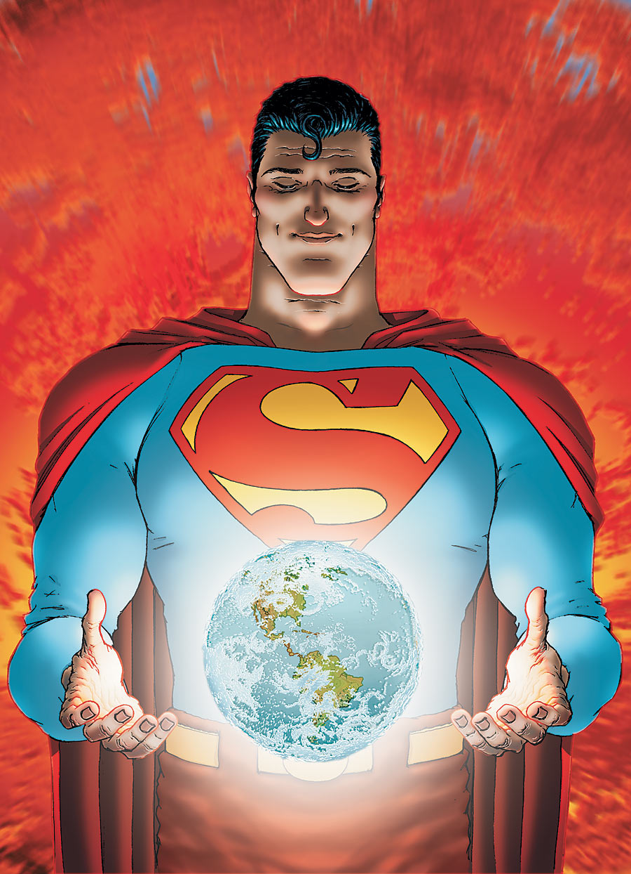
Episode 10: “Neverending”

Slide 32
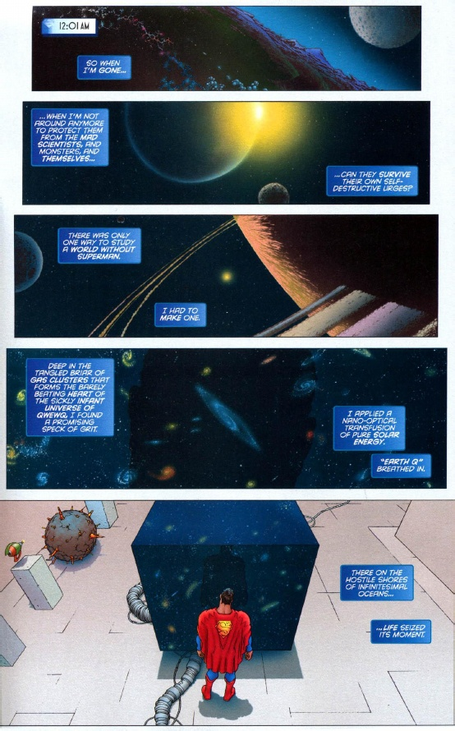

Slide 33
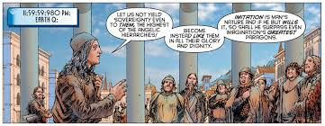
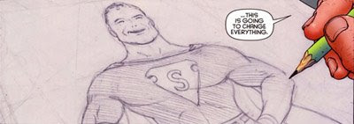

Slide 34
Key issues: Episode 10, “Neverending”
The most important Issue in All-Star Superman
Sums up all the issues and themes in All-Star Superman
Captures enlightenment values
Superman literary creates the world (Earth-Q)
Creation as artistry (artistic vision and aspiration)
Humans creating and imitating an ideal
Fictional ideal has transformative power
Theme: Human potential (to surpass their own limitations)
Theme: human’s aspiring to a higher ideal (superhuman)
Theme: Representation and idolatry
Question of responsibility –are humans self-destructive or progressive?
should/can they take responsibility for social problems?

Slide 35
Episode 12: Superman in Excelsis
Co-existence of past and future with the present
“always and forever” (273)
Culmination of his transformation into mythic stature
Time and space are connected; cosmic energy (new Krypton and earth)
Humans must live up to their ideal: perfection
Human faith in secular saint (ideal) and in scientific rationalism
Superman defeats Solaris (the tyrant sun)
Ultimate depiction of his altruism, compassion, omnipotence

Slide 36
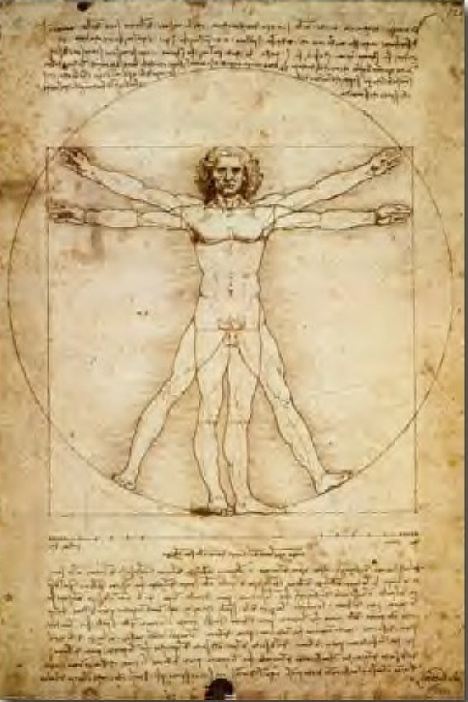
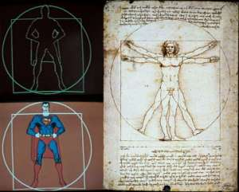
Vitruvian Man-Da Vinci, 1490

Slide 37
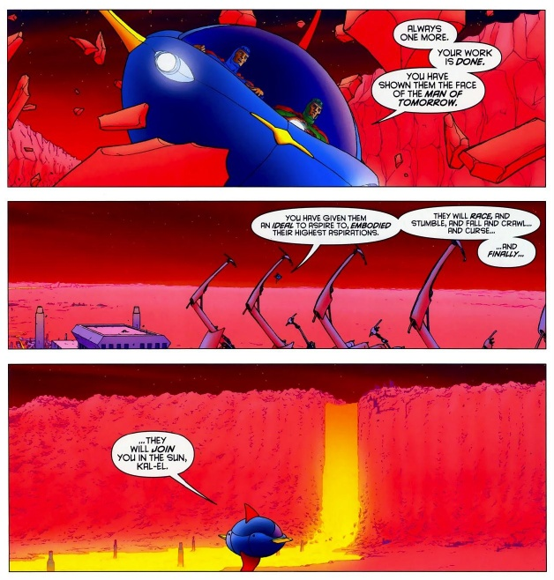

Slide 38
Episode 8: “Us Do Opposite”
Bizarro world
“Zibarro”-clone of a clone; flawed of the already flawed (double-inversion of superman)
Underverse
Site of chaos and confusion; disorder
Superman’s descent into the underworld
“twisted copies” of Superheroes
Zibarro- points to theme in Superman: alternate versions of Superman

Slide 39
Lex Luthor
Harks back to traditional mad-scientist
Luthor very humanized
The worst in humanity
Vain, insecure, needs validation and recognition
Megalomaniac (egoist)
Delusional
Epiphanic moment-sees life through Superman’s eyes
Short-lived moment
strong tension between his inadequacy and how “super” he wants to be (very human tension)

Slide 40
Governing Trope: Replacement Supermen
Theme of imitation, mirroring
Idea of the “Replicant” (Blade Runner)
Future descendants of Superman
Seen in issue 9: “Curse of the Replacement Supermen” (Bar-el)
Seen in issues 7 & 8: “Being Bizarro” and “Us do Opposite”: Zibarro
Samson and Atlas
Superman Squad
Lex Luthor (at the end)

Slide 41
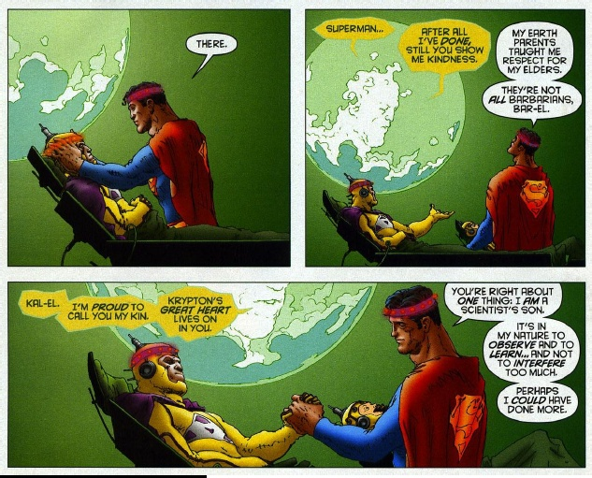
The redeemer (Supersavior)

Slide 42
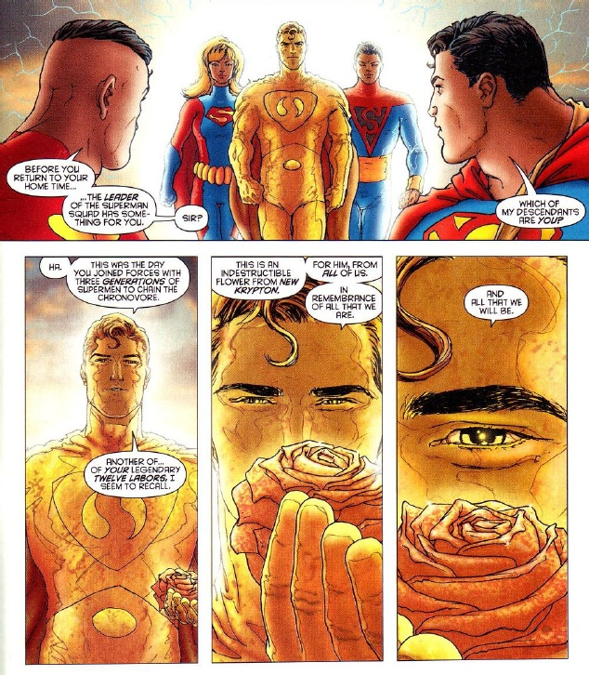
Superman Squad (Issue 6: “Funeral in Smallville”)

Slide 43
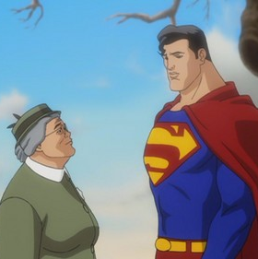
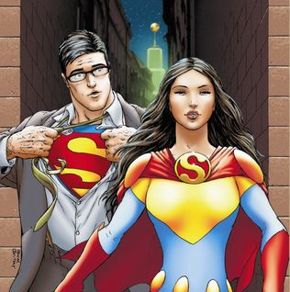
Style: reality and fantasy
Fantastical Portrayal
Realistic Portrayal

Slide 44
Frank Quitely’s Craft: Style & Form
Highly structured (ordered panel layout, grid structure)
Very clear delivery of storyline
Structure informs the classic characters, content, and storyline
Use of mathematical lines; geometric
Realism blended with fantasty

Slide 45
Leo Quintum: Superscientist
New character
Utopian scientist
Represents the positive potential of Science
Figure of enlightenment—science as progressive
not mad-scientist archetype (opposite Luthor)
Trickster archetype
He understands to formula to re-create Superman
Superlogo at end-Quintum as capitalist?
Creating a brand
Scientist as creative artist

Slide 46
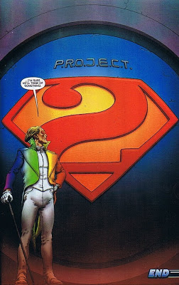
Superlogo

Slide 47
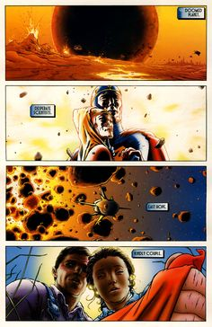
Formula to Superman Story-Issue 1

Slide 48
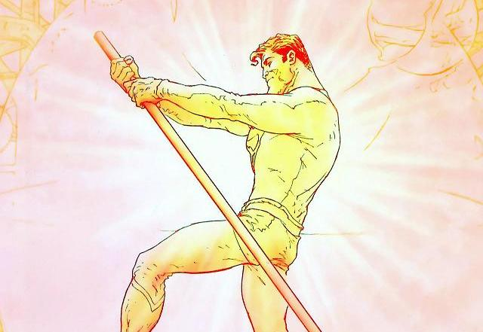
Solar Cycle End

Slide 49
Themes in All-Star Superman
Human are responsible to live up to their ideals (we template our ideal selves in Superman)
Everything is connected to everything else
Search for meaning, fellowship in loss and decay (poetry)
Promise of a better future
Large effect of small, daily acts of kindness-Superman’s greatest gift to humanity

Slide 50
Helpful links:
https://en.wikipedia.org/wiki/All-Star_Superman
http://tvtropes.org/pmwiki/pmwiki.php/ComicBook/AllStarSuperman
https://www.youtube.com/watch?v=6VO9505oVkM
Comic Book Superheroes unmasked (Part one):
https://www.youtube.com/watch?v=TKT0LLPgSnA

